Slide 1

PROJECT NAME:
SMART PARTKING MANAGEMENT SYSTEM
Name: MAHIRWE YVETTE
ID:26510
Course: PL/SQL

Slide 2
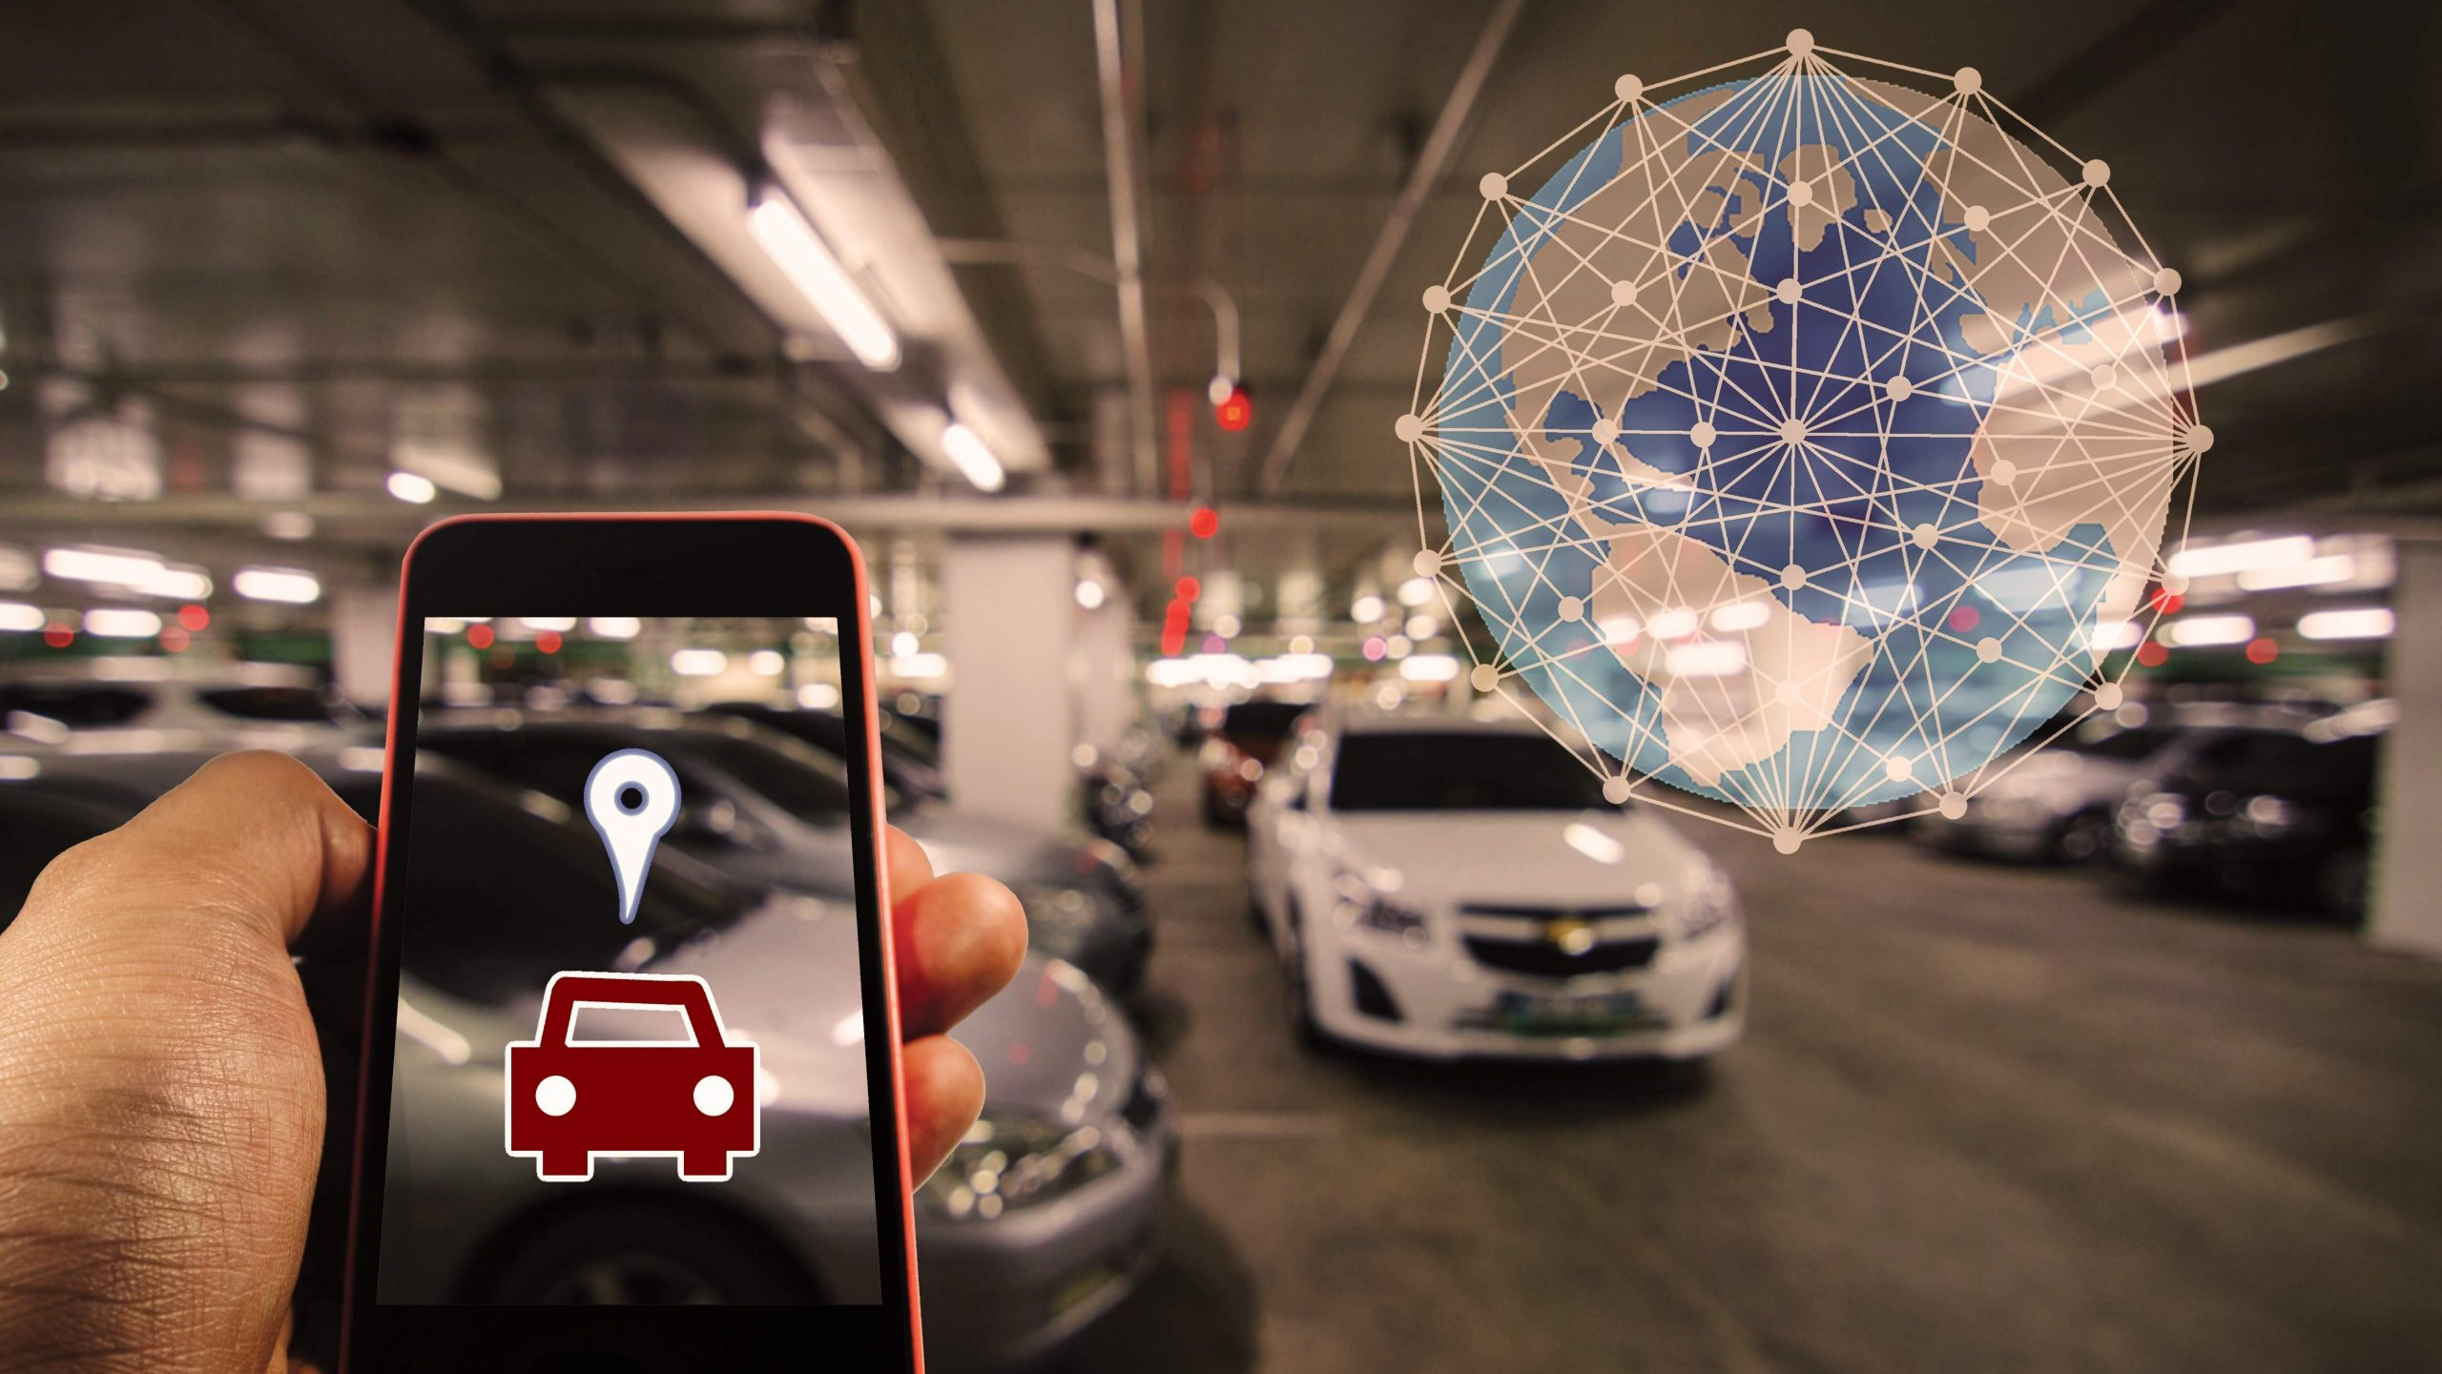
SMART PARKING MANAGEMENT SYSTEM
Project Definition:
This is a parking management system that is designed to optimize parking space availability and streamline the reservation process in busy urban areas.

Slide 3





Target Users:
Drivers
Companies that control public parking spaces
Maximize Parking Efficiency : Utilize available spaces effectively.
Simplify Reservations :Allow users to book parking spots in advance.
Enhance User Experience : Provide a smooth and convenient parking process.
Reduce Traffic Congestion : Minimize vehicle movement in search of parking.
Problem Definition:
Traffic Congestion & Wasted Time
Inefficient parking space utilization
Unauthorized Parking & Security Issues
Context: (Where and how)
Where? : Public parking spaces
How?:By optimizing parking space availability and boost the reservation process.

Slide 4
BENEFITS
Saves Time :Quick access to available parking. . Reduces Traffic : Less congestion in busy areas.
Boosts Revenue :Better space management increases earnings.
MAIN ENTITIES
Customers: Stores driver details and payment information such as: Customer ID, Name, Email, Phone Number, Vehicle Details (License Plate).
Parking Spaces : Manages slot availability and locations that stores: Parking Space ID Location (Address),Slot Number, Availability Status (Available/Occupied/Reserved),Parking Type (Regular, Handicap, VIP, Electric Vehicle),Price per hour.
Reservations : Tracks bookings and transactions and stores :Reservation ID, Customer ID, Parking Space ID ,Start Time and End Time, Payment Status, Reservation Status (Confirmed/Canceled/Completed)
Parking Lot Operators: Oversees space allocation and pricing: Operator ID, Name (Company or Individual),Contact Information

Slide 5

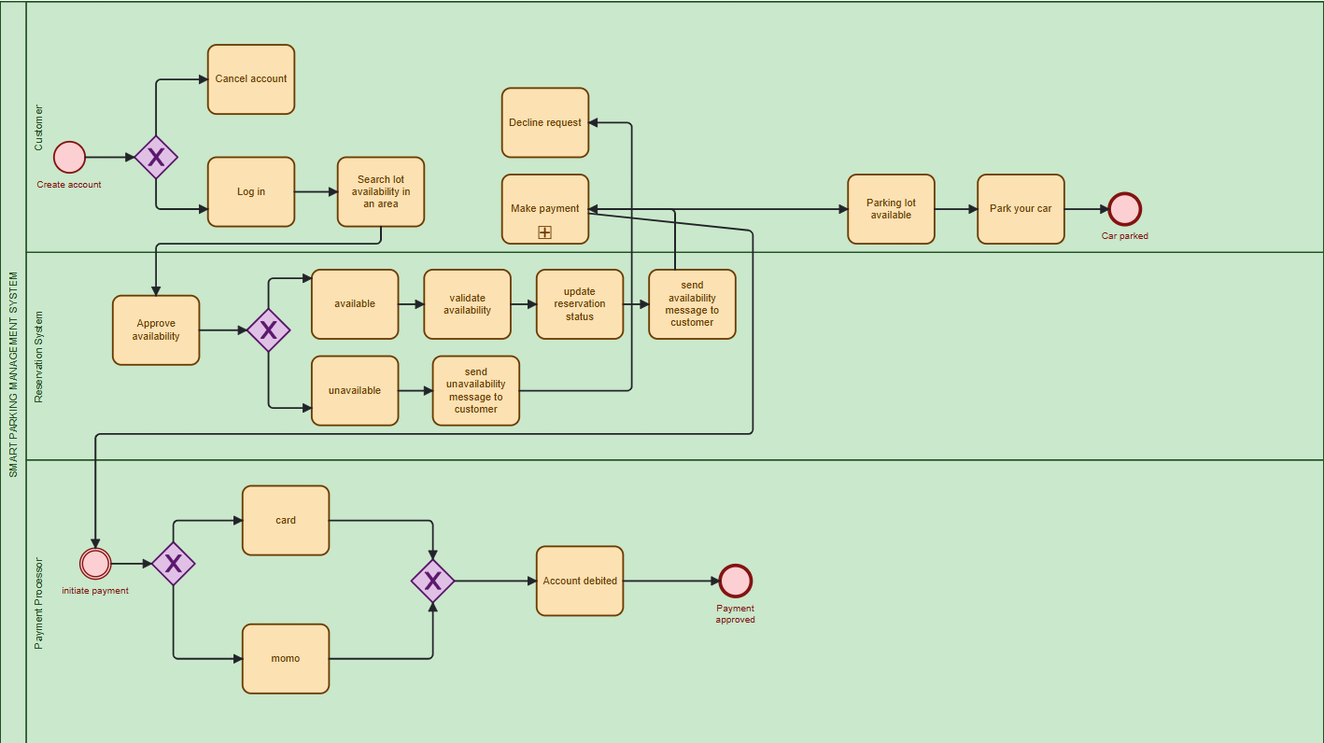
Methodology & Approach
Business Process Model and Notation
This diagram include key elements such as start and end points, tasks, decisions, and data flows.

Slide 6
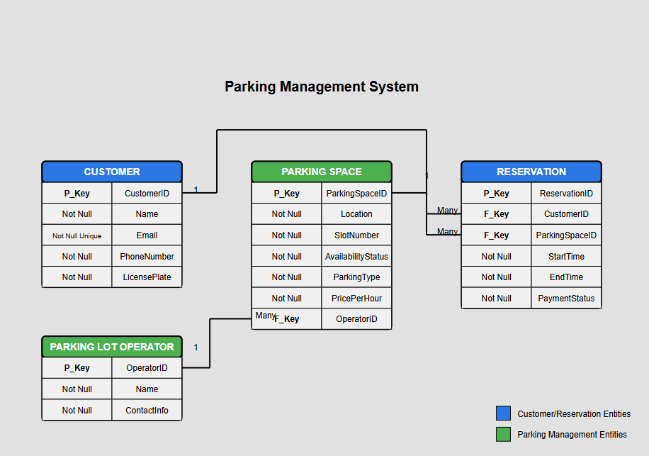
ENTITY-RELATIONSHIP DIAGRAM

Slide 7

SQLS Operations AND PL/SQL Modules:
SQL OPERATIONS
DDL (Data Definition Language): Defines and manages database structures.
CREATE, ALTER, DROP used to set up and modify tables (e.g., Customers, Reservations, ParkingSlots).
DML (Data Manipulation Language): Interacts with the data itself.
INSERT, UPDATE, DELETE used for reservation, payment, and audit data operations.

Slide 8
PL/SQL MODULES
Procedures: Automate repetitive logic.
reserve_slot() handles customer reservation
process_payment() manages payment transactions
Functions: Return computed values.
calculate_fee(entry_time, exit_time) computes dynamic parking charges
Packages: Groups related procedures/functions for modular design.
Exception Handling: Catches errors like overbooking or access on restricted days, enhancing reliability

Slide 9
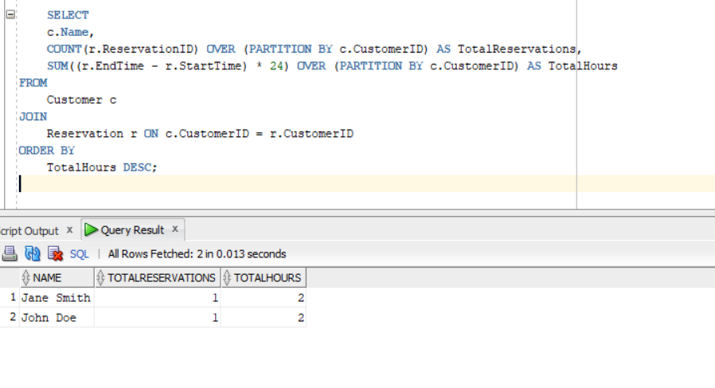
RESULTS
Results base on the queries that help see the results of the functions, procedures, triggers and cursors used in the eg. The following image shows the total number of reservations and hours reserved per customer, ranked by total hours.

Slide 10
References
Notes of the Lecturer
Oracle Corporation. PL/SQL Language Reference. Oracle Database 19c Documentation. Retrieved from https://docs.oracle.com/en/database/oracle/oracle-database/19/
https://www.geeksforgeeks.org/plsql-triggers/
https://docs.oracle.com/en/database/other-databases/timesten/22.1/plsql-developer/pl-sql-procedures-and-functions.html#GUID-1004A9F5-864E-41D5-8AF1-9733D5A8781F

